Slide 1
Graphics Device Interface
Also known as the GDI
Programming – Introduction to C#
Last modified 12/12/16 by Alex Mackay

Slide 2
Contents
// Mouth Brush
Brush mouthBrush = new SolidBrush(Color.Red);
g.FillEllipse(faceBrush, this.ClientRectangle);
g.FillEllipse(eyeBrush, eyeOnePosition);
g.FillEllipse(eyeBrush, eyeTwoPosition);
g.FillEllipse(mouthBrush, mouthPosition);
mouthBrush.Dispose();
faceBrush.Dispose();
eyeBrush.Dispose();
What is GDI?
Using GDI
GDI and Windows Forms
A few examples

Slide 3
What is GDI?
The GDI (Graphic Device Interface) is a set of common controls built to enable graphics on both screens and printers
Supported through the Common Language Runtime
Notes:
Technically, Windows uses GDI+, and no longer supports the older GDI

Slide 4
Using GDI
All GDI draw functions are called on a Graphics object owned by the form/control that is to be modified
Windows Forms makes accessing the Graphics object for the form very easy
private void Form1_Paint(object sender, PaintEventArgs e)
{
//Get the Graphics Object that we will use for drawing
Graphics g = e.Graphics;
Notes:
Graphic objects for a form/control can be accessed either by:
1. Accessing the Graphics property of the PaintEventArgs passed into the Paint event of a form.
2. Call the CreateGraphics() function in any code run by a Control or Form to receive the Graphics object for that Control/Form
3. Graphics Objects can be gotten from a Image object, allowing you to render and change a pre-existing image.

Slide 5
Using GDI
Selecting the colour of the rendered shape is done using Pens and Brushes
Different types of Pens and Brushes produce different colours and effects when they are used
private void RenderUsingPen(Graphics g)
{
//Create a 25px wide red pen
Pen redPen = new Pen(Color.Red, 25);
//...
redPen.Dispose();
}
Notes:
Pens and Brushes both derive from IDisposable, and use unmanaged memory internally.
Students should make sure that they call the Dispose function when they’ve finished using them, to ensure that the memory is correctly freed.
While the design pattern states that the pens/brushes should technically free all unmanaged memory when they go out of scope, its good practice to manually dispose the object to ensure that the memory is freed.

Slide 6
Brushes
Brushes are used for all Fill<type> functions
There are different types of Brushes that produce different effects

Slide 7
Brush Examples - SolidBrush
private void RenderUsingSolidBrush(Graphics g)
{
Rectangle drawRect = new Rectangle(50, 50, 300, 300);
Brush solidBrush = new SolidBrush( Color.Red) ;
g.FillRectangle(solidBrush, drawRect);
solidBrush.Dispose();
}

Slide 8

Brush Examples - SolidBrush

Slide 9
Brush Examples - HatchBrush
HatchBrush
private void RenderUsingHatchBrush(Graphics g)
{
Rectangle drawRect = new Rectangle(50, 50, 300, 300);
Brush hatchBrush = new System.Drawing.Drawing2D.HatchBrush(
System.Drawing.Drawing2D.HatchStyle.Cross, Color.Red) ;
g.FillRectangle(hatchBrush, drawRect);
hatchBrush.Dispose();
}
Notes:
There are a lot of HatchStyles to choose from, and some have a few more colour options than just the one passed in to the constructor.
Once again MSDN has a list of different HatchStyles

Slide 10
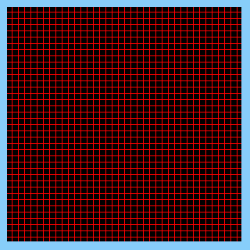
Brush Examples - HatchBrush
HatchBrush

Slide 11
Brush Examples – LinearGradientBrush
private void RenderUsingGradientBrush(Graphics g)
{
Rectangle drawRect = new Rectangle(50, 50, 300, 300);
Brush gradientBrush = new System.Drawing.Drawing2D.LinearGradientBrush(
drawRect, Color.Red, Color.Blue, System.Drawing.Drawing2D.LinearGradientMode.Vertical) ;
g.FillRectangle(gradientBrush, drawRect);
gradientBrush.Dispose();
}

Slide 12
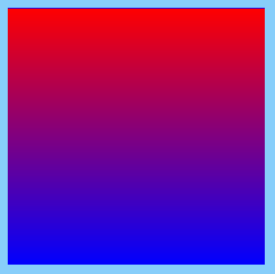
Brush Examples – LinearGradientBrush

Slide 13
Other Brush Types
TextureBrush – Render a pattern based on a loaded image
PathGradientBrush – Much more complex version of the Gradient Brush
Notes:
Pens can be customized a lot more than the example shown here.
They can be created from Brushes if you want to add a gradient, and can have different patterns applied (For rendering dashed/dotted lines, etc)
More info can be found on MSDN (link included in the reference section of the slide)

Slide 14
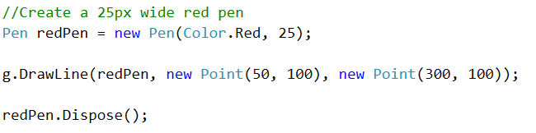

Pens
Pens are used by all Draw<type> functions
They can also be used drawing outlined shapes
Notes:
Pens can be customized a lot more than the example shown here.
They can be created from Brushes if you want to add a gradient, and can have different patterns applied (For rendering dashed/dotted lines, etc)
More info can be found on MSDN (link included in the reference section of the slide)

Slide 15
Shapes
FillRectangle
FillEclipse
FillPie
FillPath
FillPolygon
DrawLine
DrawRectangle
DrawEcilpse
DrawPie
DrawPath
And more...
Notes:
Pens can be customized a lot more than the example shown here.
They can be created from Brushes if you want to add a gradient, and can have different patterns applied (For rendering dashed/dotted lines, etc)
More info can be found on MSDN (link included in the reference section of the slide)

Slide 16
GDI and Windows Forms
Override the Paint Event:
Window bounds can be found using the ClientRectangle:
private void Form1_Paint(object sender, PaintEventArgs e)
{
//Get the Graphics Object that we will use for drawing
Graphics g = e.Graphics;
//This holds the area of the window
Rectangle clientArea = this.ClientRectangle;

Slide 17
GDI and Windows Forms
Call the Invalidate() function to force a window redraw
private void Form1_Resize(object sender, EventArgs e)
{
Invalidate();
}

Slide 18
A few examples – Colour the background
private void Form1_Paint(object sender, PaintEventArgs e)
{
//Get the Graphics Object that we will use for drawing
Graphics g = e.Graphics;
//This holds the area of the window
Rectangle clientArea = this.ClientRectangle;
Brush backgroundBrush = new SolidBrush(Color.LightSkyBlue);
g.FillRectangle(backgroundBrush, clientArea);
backgroundBrush.Dispose();
}

Slide 19
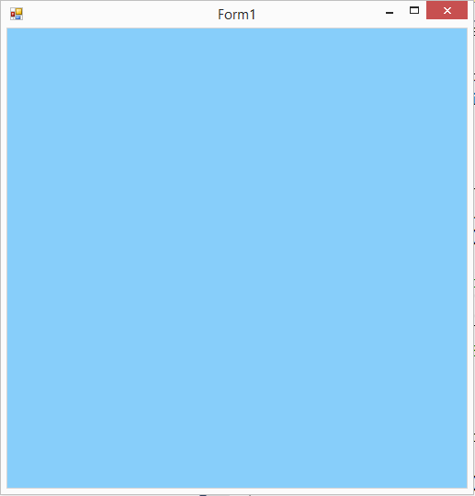
A few examples – Colour the background

Slide 20
A few examples – Nestled Spheres
private void NestledSphereExample(Graphics g)
{
Brush whiteBrush = new SolidBrush(Color.White);
Brush blackBrush = new SolidBrush(Color.Black);
Rectangle outerArea = new Rectangle(100, 100, 300, 300);
Rectangle innerArea = new Rectangle(150, 150, 200, 200);
g.FillEllipse(whiteBrush, outerArea);
g.FillEllipse(blackBrush, innerArea);
whiteBrush.Dispose();
blackBrush.Dispose();
}

Slide 21
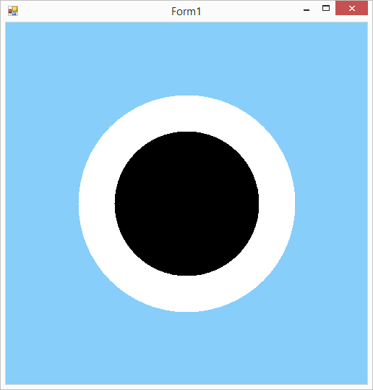
A few examples – Nestled Spheres

Slide 22
Summary
The Graphics Device Interface is a series of classes that allow us to draw to the screen (or printer)
Part of the Common Runtime Libraries
Pens and Brushes can be used to Fill and Draw shapes of different kinds

Slide 23
Further Reading
Microsoft, 2016, Graphics and Drawing in Windows Forms, MSDN
https://msdn.microsoft.com/en/us/library/a36fascx%28v=vs.110%29.aspx

